Slide 1
Financing Mechanisms of the Caisse des Dépôts et Consignations

Slide 2
In brief
The Caisse des Dépôts et Consignations (CDC) is a public institution, created in 2011, acting as the financial arm of Tunisia with the mission of supporting its investment policies.
Its status gives it the role of a key player in the economic and social development of Tunisia to serve the general interest over a long-term horizon.

Slide 3
Mission
The CDC is responsible for the custody and management of the resources made available to it by the State or those it mobilizes by making investments in various categories of treasury bills and other guaranteed securities as well as on the financial market. It makes investments, while ensuring their economic viability, in all areas of a strategic nature with a wide range of possible maturities, in partnership with both the public and private sectors.

Slide 4
Strategy 2021-2025

Slide 5
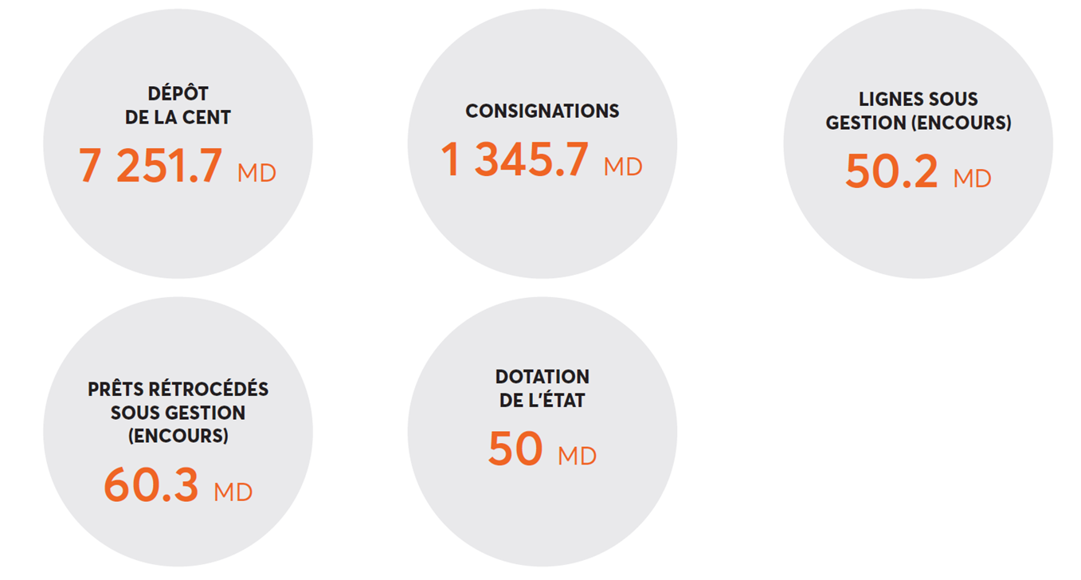
Key figures
7 852.2 MTND
528 MTND
118.9 MTND
Ressources
7 852.2 MTND
1 467.9 MTND
46.2 MTND
68.2MTND

Slide 6
Certifications
CDC, as a responsible investment entity, has placed Corporate Social Responsibility (CSR) among its priorities. Since December 2019, it has been certified CSR by the CONECT Label, validated by VERITAS, making it the first public institution to receive the CSR label.
In February 2023, CDC is enrolled in a second round of MSI 20000 certification, once again attesting to its continued compliance with international financial quality standards. The MSI 20000 assessment is based on two fundamentals: soundness and financial performance.

Slide 7
Direct Financing of Major Projects
104.9 MTND invested in 21 projects
As a long-term investor, CDC is primarily called upon to fund major projects, whether new or under development, in different sectors and regions, through equity and quasi-equity financing.

Slide 8
Indirect Financing of SMEs
FCPR
Operational Funds
24 Fonds :
21 Local funds: subscription for a total amount of 185 MTND, of which 147 MTND have been paid up 03 International funds: subscription for an amount of €15 million and $10 million have been released
Projects Invested
161 of which 54 projects invested by the funds in the ZDRs
Mezzanine Line
25,6 MTND Allocated in the form of OCAs - 14 Beneficiary companies
Sicar Line
20,8 MTND Allocated for the 6 regional Sicars – 23 Projects invested

Slide 9
Indirect Financing of SME’s
24 investment funds, 3 of which are managed by CDC Gestion
161 SMEs invested
13 management companies partner to the CDC
→ Creating Leverage: A dinar invested by the CDC in local funds is multiplied by 14.8x in terms of investment.

Slide 10
PUBLIC-PRIVATE PARTNERSHIP
Public Partner
Support
Partenaires privés
Taking participation
PPP Contract
Capital
Debts
Credit Agreements
Project Company
Shareholders' agreement
Fonds propres
Mezzanine
Subcontracts
Conception/ Réalisation
Maintenance
Ancillary services

Slide 11
Post Covid 600 MTND Fund

Slide 12
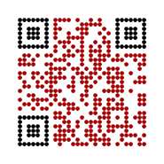
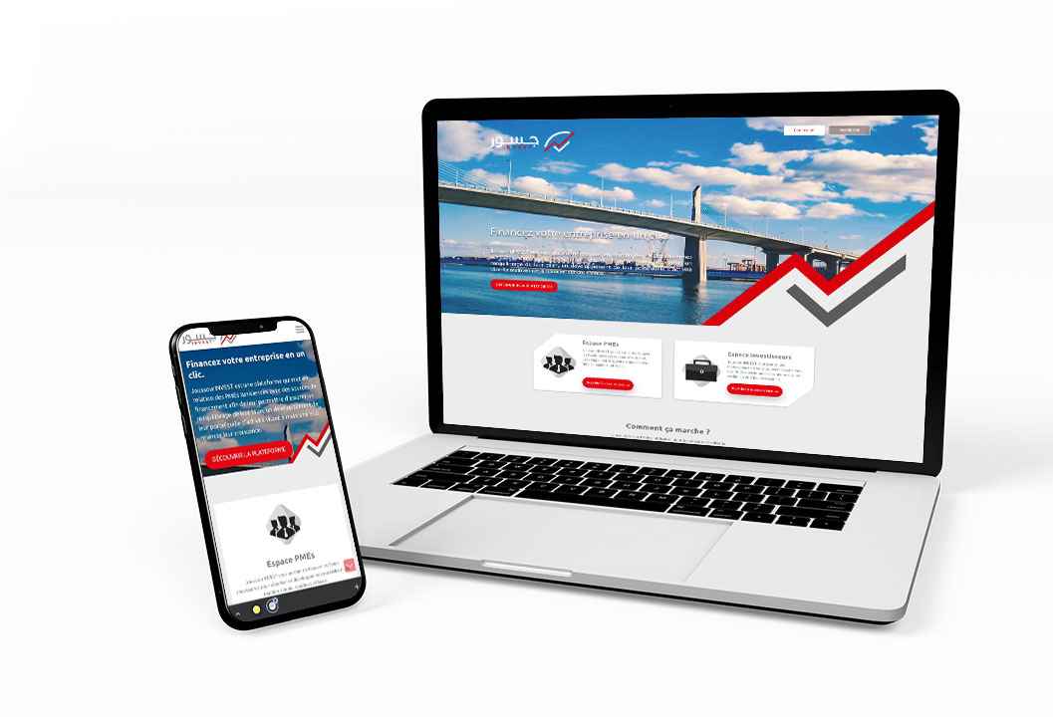
First digital platform in Tunisia Launched by institutional investors
Acts as a marketplace to connect investors and SMEs seeking capital financing to undertake financial restructuring following the COVID-19 crisis, or to strengthen and support their growth.

Slide 13
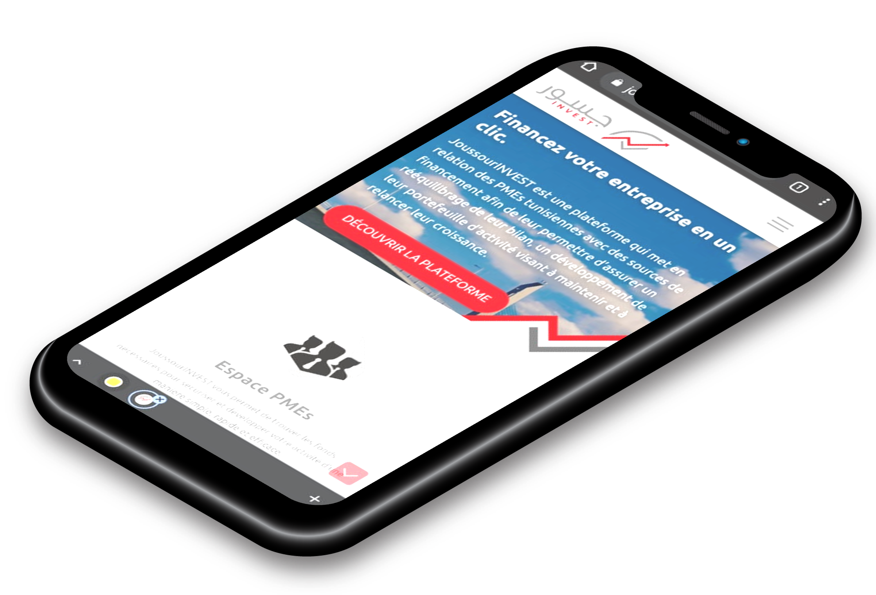
67 active investors on JoussourInvest out of 128 registered investors 3061 registered SMEs from all regions of Tunisia 522 startups registered (135 labelled) 523 applications for capital investment were submitted 37 Positive Closes (125,844 MTNDT) 93 Applications are in the Due Diligence phase 14% female promoters (2,538)
Joussourinvest.tn est une solution qui permet aux entreprises de trouver des financements en un clic!

Slide 14
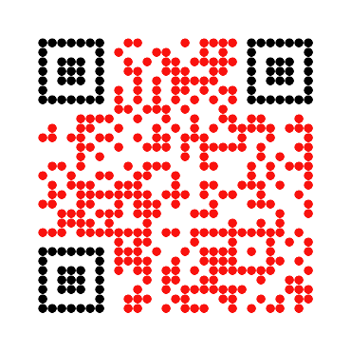
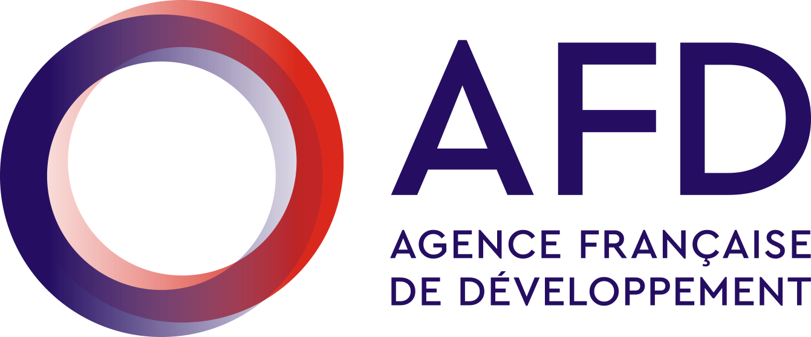
FAST
Selection of accelerator programs for startups
Programme :
Femmes et Accélération pour les Startups et TPE
Objective :
Supporting the strengthening and structuring of the entrepreneurial ecosystem.
Component 1 | Select accelerator programs that support startups beyond their ideation stage, in the development of their business and their scaling
Component 2 | Encourage the creation or strengthening of incubation programs, intended exclusively for projects led by women and located in the regions, outside the greater Tunis area.
Component 3 | Support programs that strengthen the creation of links between start-ups and medium and large companies to accelerate the development of start-ups and small businesses.

Slide 15
AIR D4D
The project Progres Migration Tunisia D4D AIR intends to engage the talented Tunisian diaspora in order to expand the Tunisian entrepreneurial network.
The budget allocated to the funding of the beneficiaries of the project is €810 000.
The project AIR D4D supported 30 startups (newly created) at a rate of €27 000 (88 884 TND) per beneficiary.
The main sectors of activity of the supported startups are E-service, HealthTech, artificial intelligence and AgriTech.

Slide 16
Initiative to support innovative startups and SMEs

Slide 17
Initiative to support innovative startups and SMEs
 | Component 1 |  |  |  | Total
 | Anava Fund of Funds (Indirect Investment) |  |  | InnovaTech Fund (Direct Co-Investment)
Investment stage | Seed Stage (US$50,000– US$300,000) | Early Stage (US$300,000– US$500,000) | Growth Stage (US$500,000– US$1,000,000) | Growth Stage (US$300,000–US$1,000,000)
Allocation | US$20 million | US$22 million | US$3 million | US$17 million | US$62 million
FIs | Accelerators, angel networks, and seed stage funds | Accelerators stage and VC funds | VC funds | Co-investment with VC funds and other private investors
Target number of funds | Up to 3 funds | Up to 2 funds | 1 fund | 1 fund | Up to 7 funds
Target fund size | Up to US$10 million | Up to US$22 million | Above US$20 million | US$34 million
Allocation per fund | Up to US$7.5 million | Up to US$11 million | US$3 million | US$17 million
Private leverage (%) | 25 | 50 | 85 | 50
Number of companies | 90–100 companies | 90–100 companies | 20–25 companies | 40–50 companies | About 280 companies
Total funds | US$27a million | US$44 million | US$20 million | US$34 million | US$125 million

Slide 18
Ecosystem Support
Flywheel est un fonds destiné à soutenir les acteurs de l'écosystème des Startups en Tunisie.
Il soutient le lancement et le développement des Startups et des structures de soutien aux Startups.
AIR: A grant for the development of POCs (Proof-of-concept) for early-stage startups. it can reach 30,000 TND and is composed of 60% subsidy and 40% repayable advance.
AIR²: An investment readiness grant for early-stage startups.
prepares and supports them to raise larger funds to be able to successfully carry out their scale-up and expansion plans.
For SSOs DEAL: A grant for the launch of new programs, up to 200k TND
SAIL: A subsidy to ensure the continuity of certified and high-performance SSOs
Flywheel provides a structured solution based on financial instruments to address today's challenges.

Slide 19
Startup Guarantee Fund
It is a guarantee mechanism for the participations of investment funds and other regulated investment bodies in startups.
This mechanism can only be activated in the event of amicable liquidation of the startup subject to the guarantee.
It aims to strengthen the role of investment companies in supporting the capital of start-ups, whose business model is based on innovation, particularly technological innovation.
SOTUGAR is responsible for the management of the fund, in order to protect the start-ups' shareholdings.

Slide 20
Capital Guarantee Fund for SME’s
Capital guaranteed funds are pooled investment vehicles that provide principal protection for investors.
These funds tend to use low-risk instruments and/or employ derivatives strategies in order to protect from losses but also provide some positive return potential, although limited.
Capital guaranteed strategies tend to be long-term and illiquid due to the way they are structured, meaning that investors may lose principal if they withdraw their money too early.
In blended Finance, we can cover first loss by public or DFI’s financement

Slide 21
Thank you for your attention

